Slide 1
Using Numerical Integration to Estimate Energy Usage

Slide 2
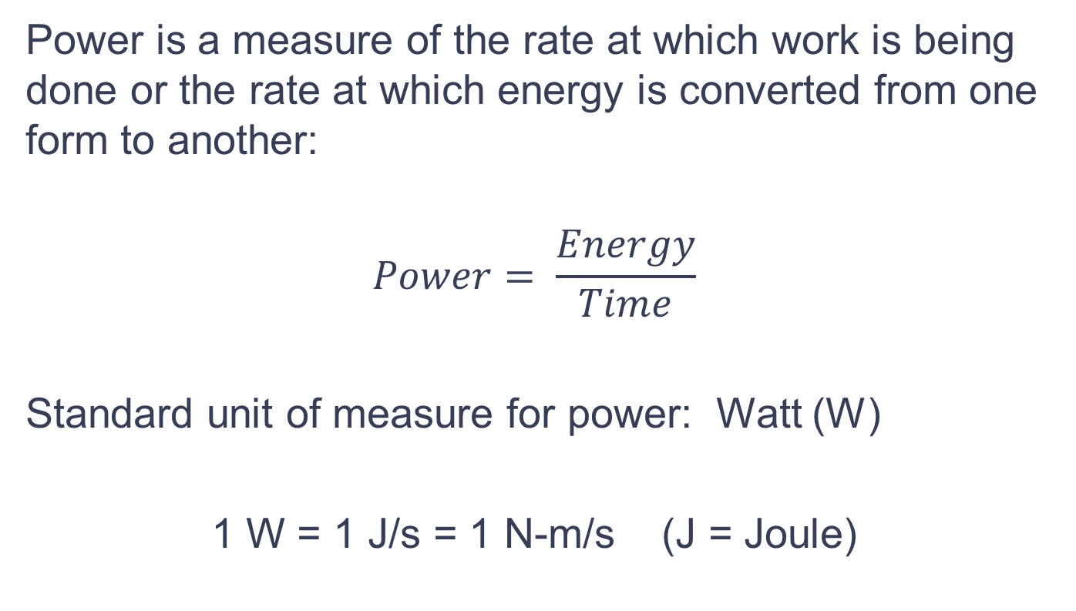
Power
Power is a measure of the rate at which work is being done or the rate at which energy is converted from one form to another:
$$Power= \frac{Energy}{Time}$$
Standard unit of measure for power: Watt (W)
1 W = 1 J/s = 1 N-m/s (J = Joule)

Slide 3
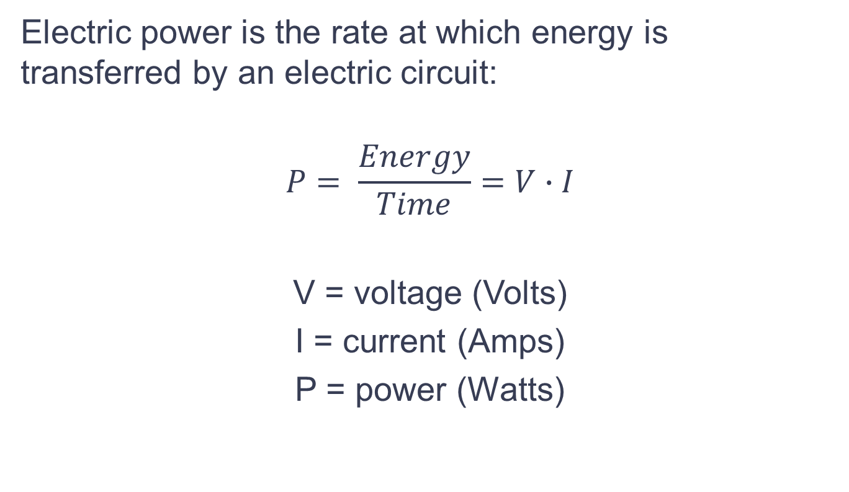
Power
Electric power is the rate at which energy is transferred by an electric circuit:
$$P= \frac{Energy}{Time}=V∙I$$
V = voltage (Volts)
I = current (Amps)
P = power (Watts)

Slide 4
Energy
The power company bills you for energy usage each month. If power (rate of energy usage) is constant:
Energy = Power * Time
Common units for Energy:
W-s (1 W-s = 1J)
kWh
Power company charges per kWh

Slide 5
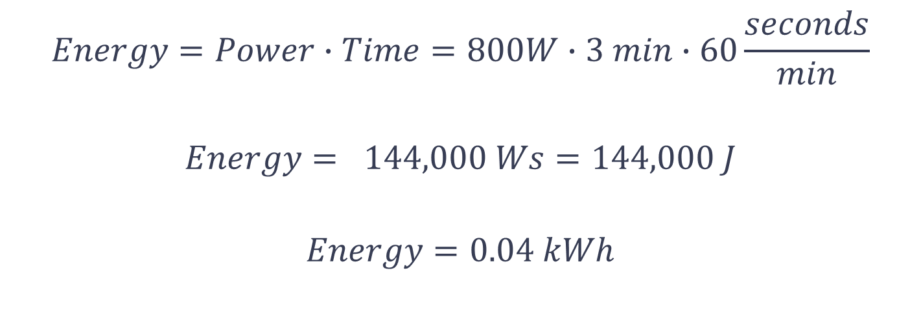
Energy Example
How much energy is required to run an 800W microwave oven for 3 minutes?
$$Energy=Power∙Time=800W∙3 min∙60\frac{seconds}{min}$$
$$Energy= 144,000 Ws=144,000 J$$
$$Energy=0.04 kWh$$

Slide 6
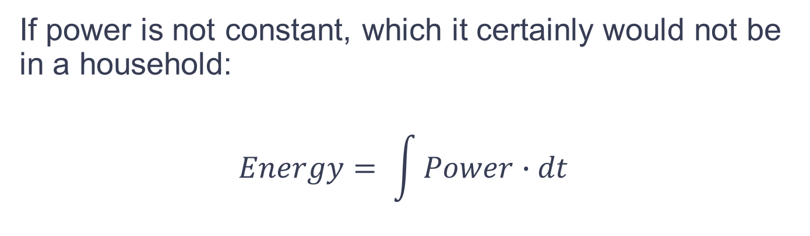
Energy
If power is not constant, which it certainly would not be in a household:
$$Energy= \int{Power∙dt}$$

Slide 7
Household Current Data
In early July 2013, a professor at the University of Cincinnati, Dr. Talaga, used a DAQ device to measure the current flow into his house.
He used two Donut Current Transformers that measure the electric field around his two input power lines and produce a voltage proportional to the current.
He fed the voltage measurements into the DAQ through a simple parallel RC filter circuit.
He plugged the DAQ into a laptop with MATLAB installed.

Slide 8
Household Current Data
Dr. Talaga wrote a MATLAB script that would take data from the Donut CTs about every six seconds and convert the voltage reading back to an estimate for the two line currents.
He started taking data on July 7th, 2013 and continued until December 27th, 2013.
He took over 1.87 million measurements over this period of time which he has graciously provided for our use.

Slide 9
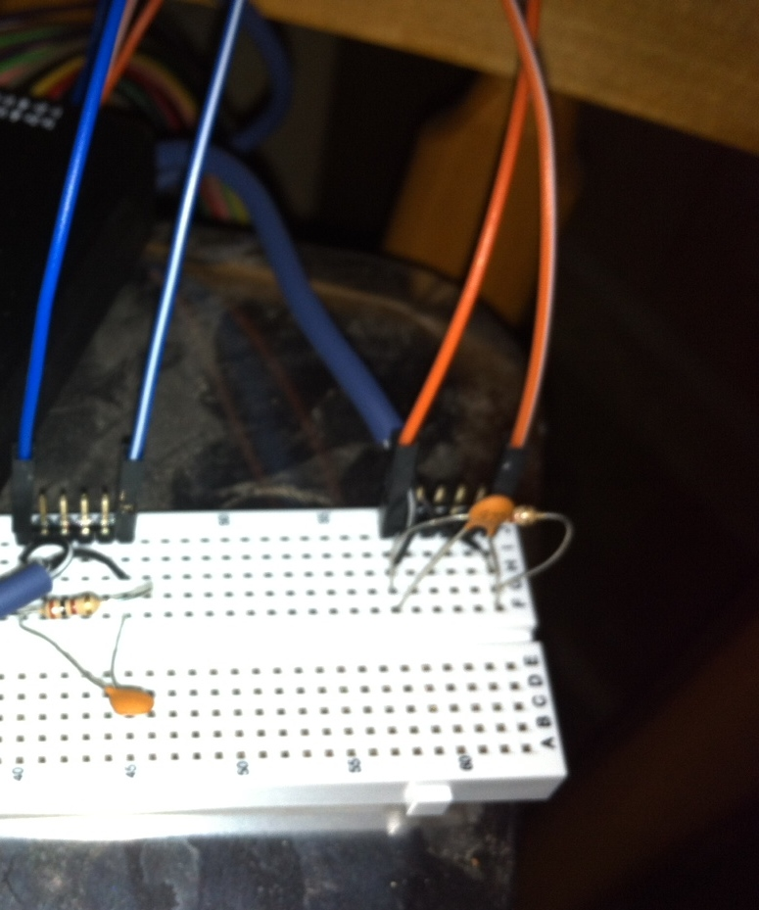
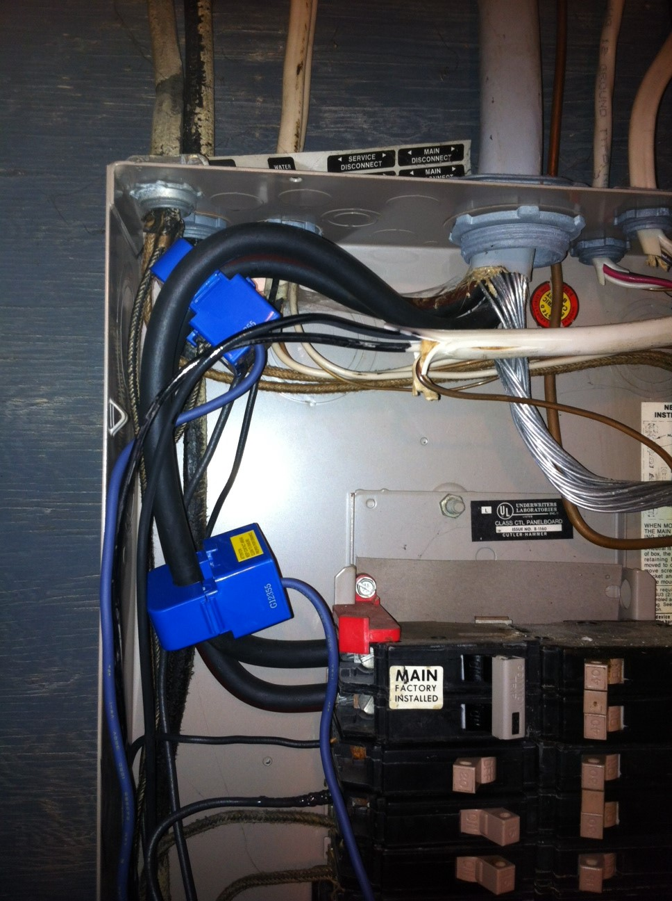
RC Filter Circuits
Donut CTs
(Current Transformers)

Slide 10

Exercise: Computing Energy Usage from Current Measurements
Use numerical integration to estimate energy usage based on Dr. Talaga’s measured current data.
Compare the results to a couple of his monthly energy bills from Duke Energy.
First calculate power based on the current measurements as follows:
$$Power=V∙I=120∙(Line1 Current+Line2 Current)$$

Slide 11
Then use the trapezoidal estimate for integration to calculate energy usage from the power measurements.

Slide 12
Notice that the time interval, dt, is not constant – doesn’t matter!
$Energy ≈ \frac{\left(678+676.8\right)}{2}\left(6\right)+ \frac{\left(676.8+676.8\right)}{2}\left(5\right)+\frac{\left(676.8+679.2\right)}{2}\left(6\right)+ \frac{\left(679.2+678\right)}{2}\left(5\right)+…$

